Slide 1
Reinforcement Learning Car Simulation using NEAT and Pygame
A Deep Dive into Evolving Neural Networks for Autonomous Driving

Slide 2
Project overview
This project uses the NEAT (NeuroEvolution of Augmenting Topologies) algorithm to evolve neural networks that control a car's movement on a simulated track. The aim is for the car to autonomously navigate the track, learning to avoid collisions while improving its driving performance over generations.
Key Components:
NEAT Algorithm
Pygame for Simulation
Reinforcement Learning

Slide 3
Objectives
To create an autonomous agent (car) that learns to navigate a track using sensor data, neural networks, and evolutionary algorithms.
To minimize collisions between the car and the boundaries
To optimize the distance traveled by the car
To maximize fitness through efficient navigation

Slide 4
NEAT Algorithm Overview
What is NEAT?
NEAT is an evolutionary algorithm that evolves artificial neural networks (ANNs).
It combines genetic algorithms with the process of neural network topology optimization.
Unlike traditional neural networks, NEAT begins with simple neural networks and gradually evolves more complex ones by adding nodes and connections over generations.
Components:
Initial Population:
NEAT starts with simple networks (small, fully connected networks with only input and output layers).
It progressively evolves by adding complexity (nodes and connections).

Slide 5
NEAT Algorithm Overview
2. Mutations:
Weight Mutation: Alters the weights of the network connections.
Structural Mutation: Adds new nodes or connections, allowing the network to become more complex.
3. Crossover (Recombination):
Combines two parent neural networks to create offspring.
NEAT tracks the historical origin of each gene to align structures and handle different topologies during crossover.
4. Speciation:
Protects innovation by grouping similar neural networks into species.
Ensures that new, less optimized topologies have time to evolve without getting wiped out by more optimized ones.

Slide 6
NEAT Algorithm Overview
5. Fitness Evaluation:
Each neural network is evaluated based on how well it performs the task.
Fitness scores are used to select the best networks for reproduction.
6. Survival of the Fittest:
Networks with higher fitness are more likely to be selected to create the next generation.
Poorly performing networks are less likely to reproduce or may be removed from the population.
7. Innovation:
NEAT ensures innovation is preserved by keeping track of historical markings for each new structure (genes).
This helps avoid the problem of "destructive mutations" that could harm the evolutionary process.

Slide 7
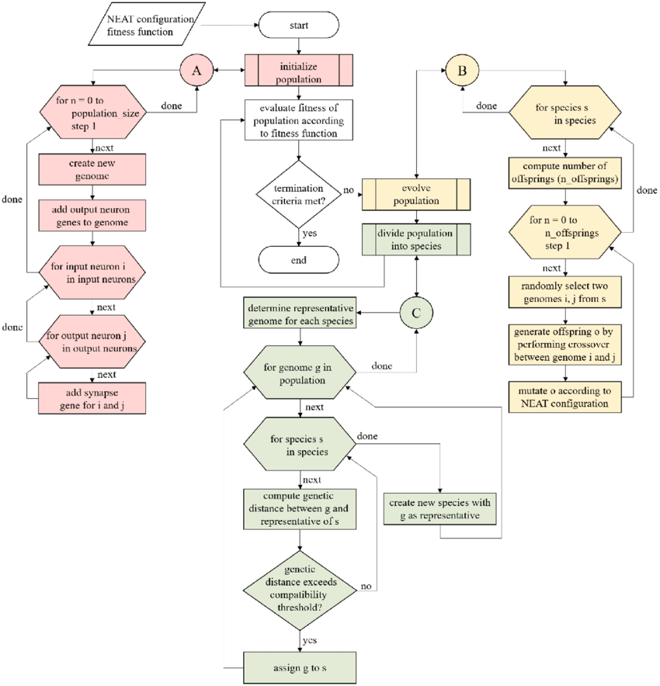
1
Fig: NEAT Algorithm Flowchart

Slide 8
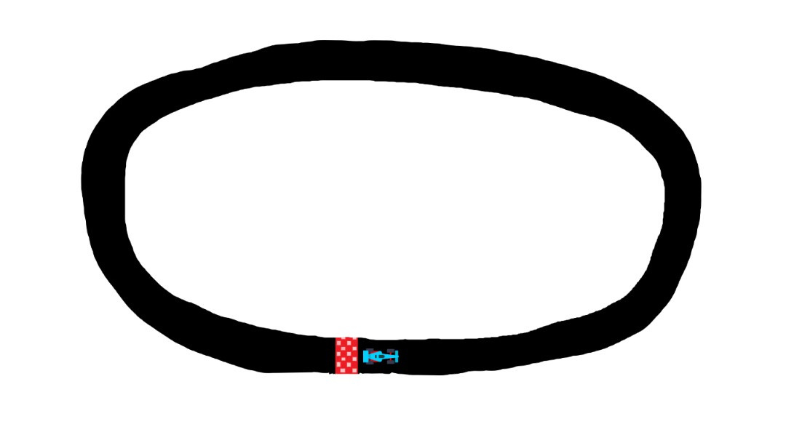
Simulation
Libraries Used:
Pygame: For the graphical simulation of the car.
NEAT: For evolving neural networks.
Environment Setup:
Track size: 1920 x 1080
Fig: Image of the track with the model car

Slide 9
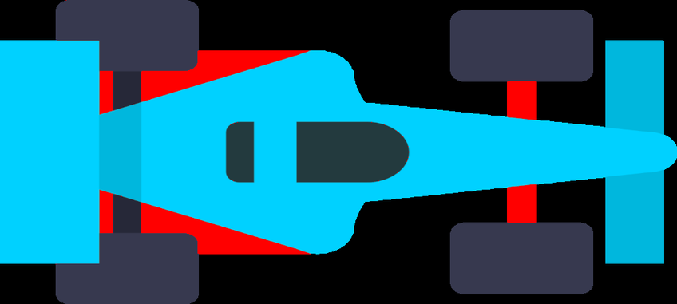
Car Design
Car Class:
The car is represented by a sprite that can rotate and move around the screen.
The car is equipped with radars (sensors) to detect obstacles and boundaries.
Key Attributes:
Speed and angle for movement
Collision detection
Radars for sensing distances
Fig: Car Model

Slide 10
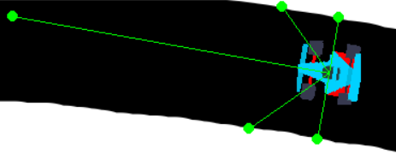
Sensors & Collision Detection
Radar System:
The car is equipped with 5 radars that measure the distance to the track boundary and helps adjust the car's direction to avoid collisions. These radars are essential in guiding the car's decision-making by providing information about its surroundings.
Collision Detection:
If any of the car's corners touch the track boundary (white lines), the car is considered "crashed" and loses fitness points.
Fig: Car with radars

Slide 11
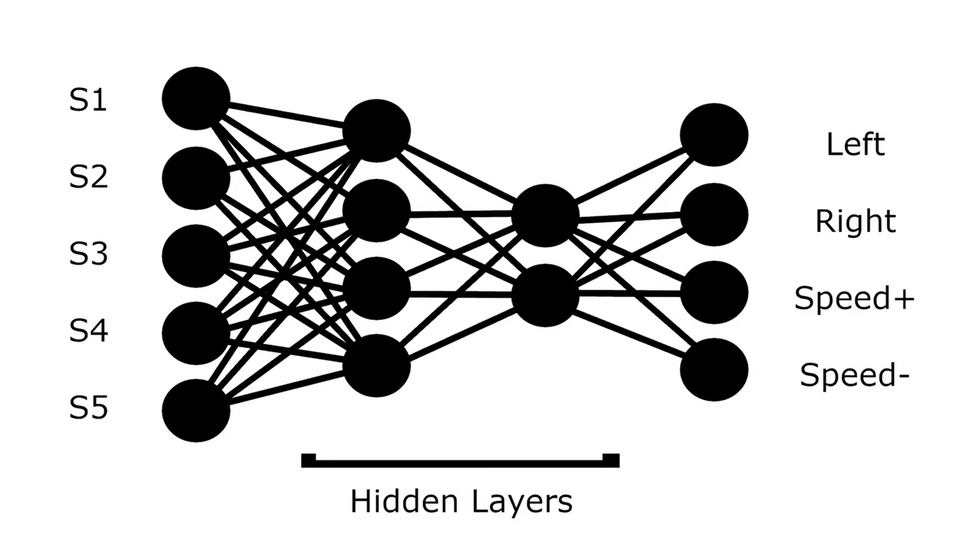
Neural Network
Network Structure:
Inputs: 5 radar distances (normalized)
Outputs: 4 control actions (left, right, accelerate, decelerate)
Actions Based on Output:
Turn left or right
Increase or decrease speed
Fig: Neural Network structure

Slide 12
Fitness Function
The fitness function is crucial for guiding the car's learning process. It rewards or penalizes the car based on its performance in two key areas:
Distance Traveled: The car is rewarded for the total distance it covers on the track. This encourages it to stay alive longer and explore more of the track. The greater the distance, the higher the fitness score, motivating the car to keep moving forward efficiently.
Collision Avoidance: If the car crashes into track boundaries (white lines), its fitness score is penalized. This helps reinforce the car's learning to avoid boundaries and maintain control. Cars that avoid collisions for longer periods are rewarded with higher fitness.

Slide 13
NEAT Configuration
NEAT Parameters:
Population size: 30
Fitness criterion: Maximize fitness
Fitness Threshold: 100,000,000
Max generations: Evolution runs up to 1000 generations to optimize the car's performance.
Mutation rate: Uses an adaptive mutation rate to ensure a balance between exploring new solutions and refining existing ones.
Stagnation Parameters:
Number of generations without improvement: 20 (Max Stagnation)
Number of top individuals kept per species: 2
Evolutionary Strategy:
Species are formed based on similarity.
The fittest networks from each species are allowed to reproduce.

Slide 14
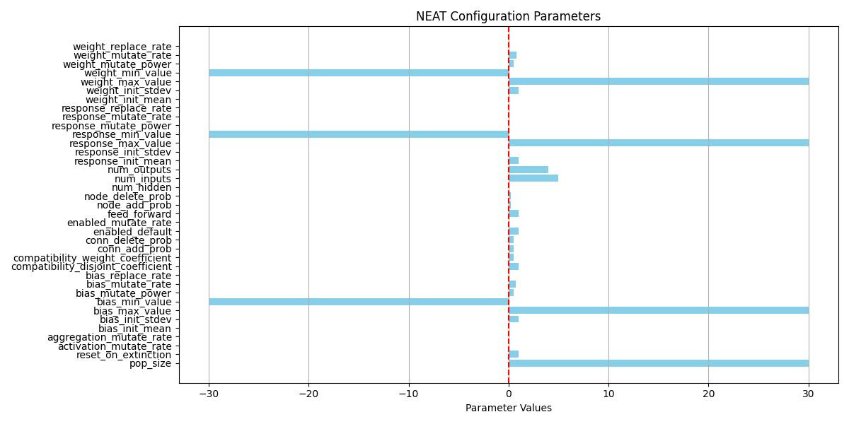
Fig: Graph of the NEAT Configuration Parameters

Slide 15
Results and Performance
Generational Improvements:
Over generations, the car demonstrated clear improvements in both the distance traveled and its ability to avoid collisions.
The NEAT algorithm continuously evolved more effective neural networks, enhancing the car’s performance with each generation.
Metrics:
Generation Count: Keeps track of the number of generations evolved throughout the training process.
Best Fitness Score: Monitors the fitness score of the best-performing car in each generation, highlighting the progress.

Slide 16
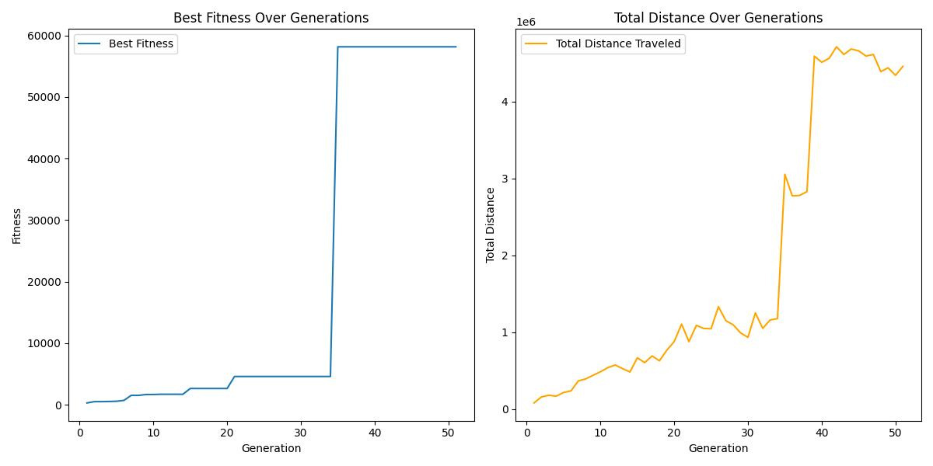
Fig: Graphs of Best Fitness over Generations and Total Distance Over Generations

Slide 17
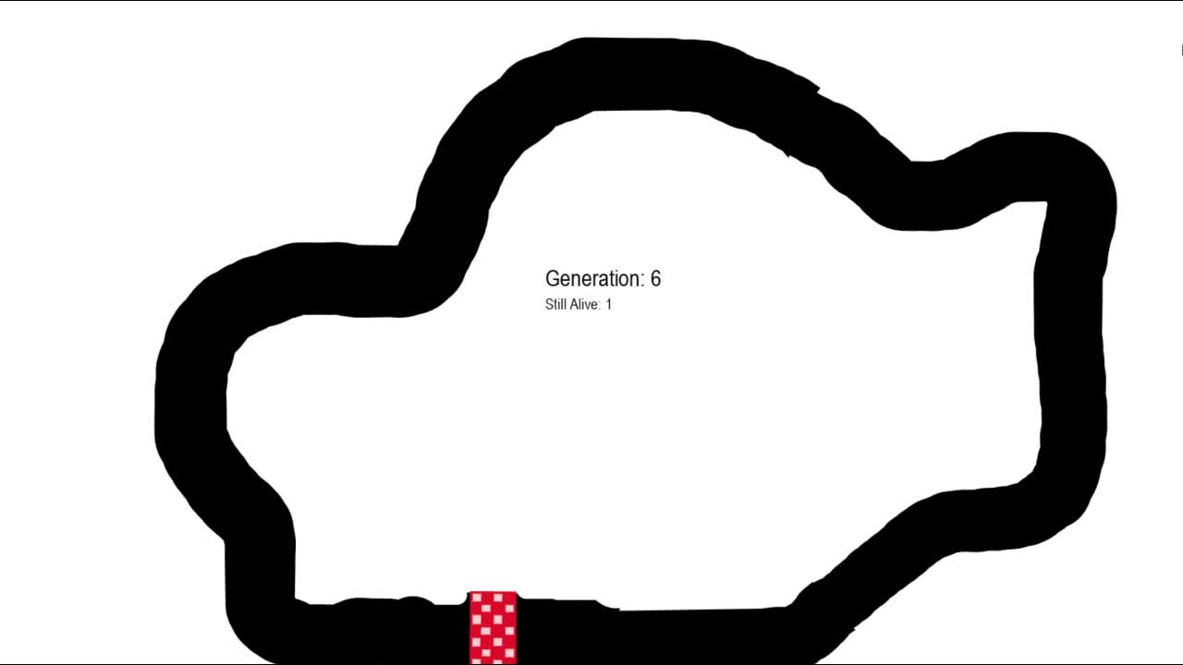
Simulation

Slide 18
Future Improvements
Curved Tracks:
Introducing more complex tracks, such as Formula 1-style circuits, to challenge the learning process.
Car Physics:
Implementing more realistic car dynamics (e.g., acceleration, friction).
Obstacles(Static/Dynamic):
Placing obstacles(both static and dynamic) for better learning and more realistic scenarios.
Advanced Neural Networks:
Exploring deeper networks or recurrent architectures for better decision-making.

Slide 19
Thank You

